Slide 1




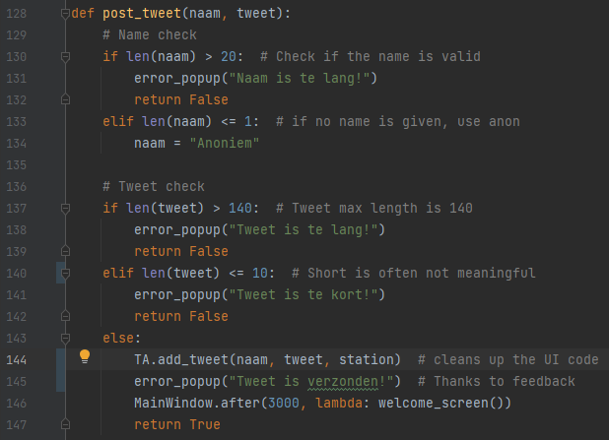
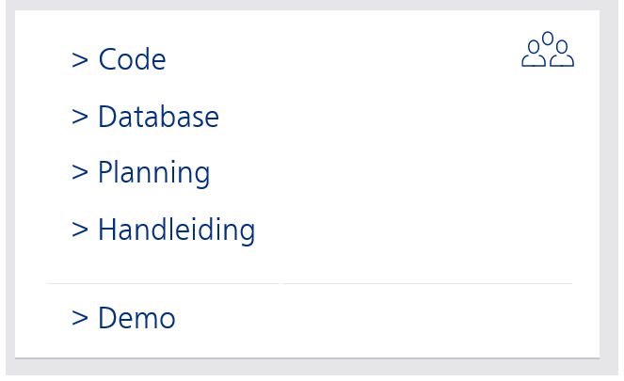
Code: Layout

Slide 2
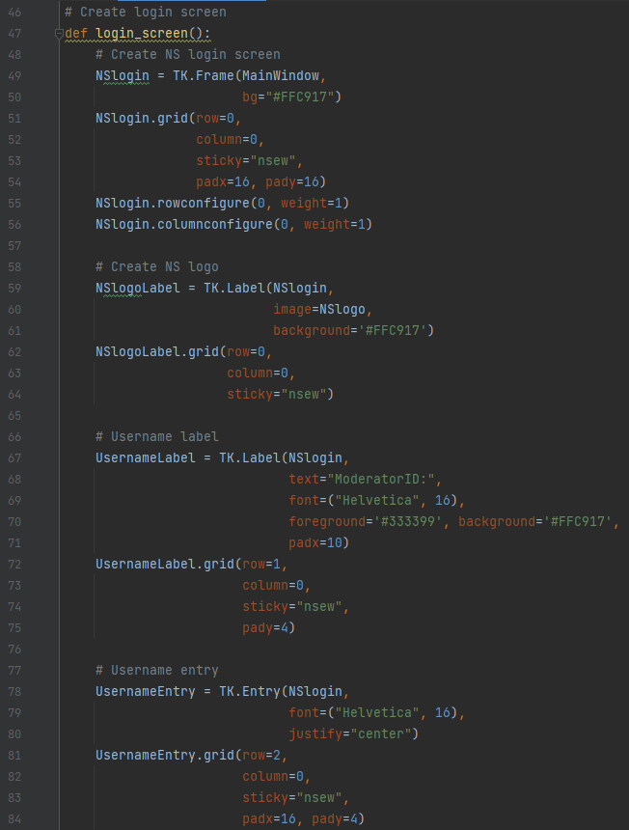
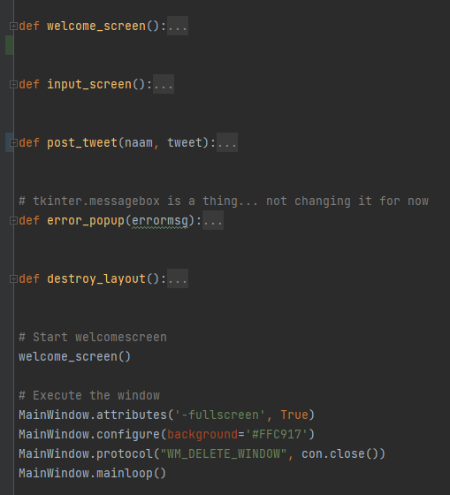
Code: UI en DB
Code: Layout

Slide 3
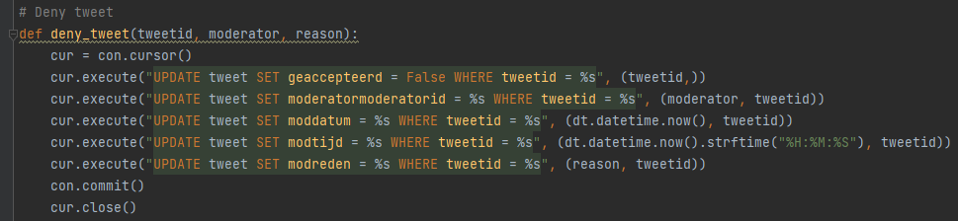
Code: Layout
Code: UI en DB

Slide 4
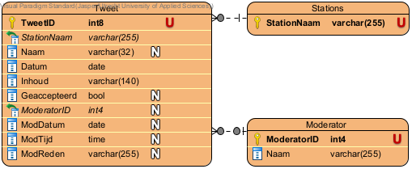
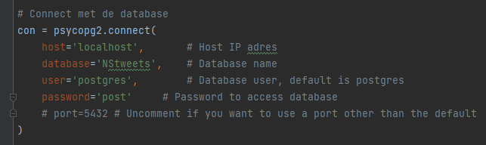
Database
Code: UI en DB

Slide 5
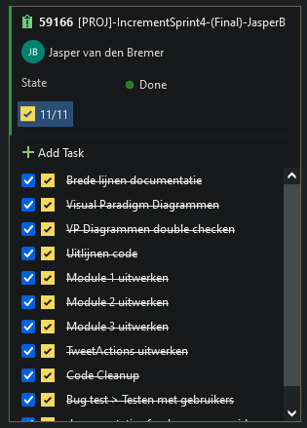
Code: UI en DB
Planning
Database

Slide 6
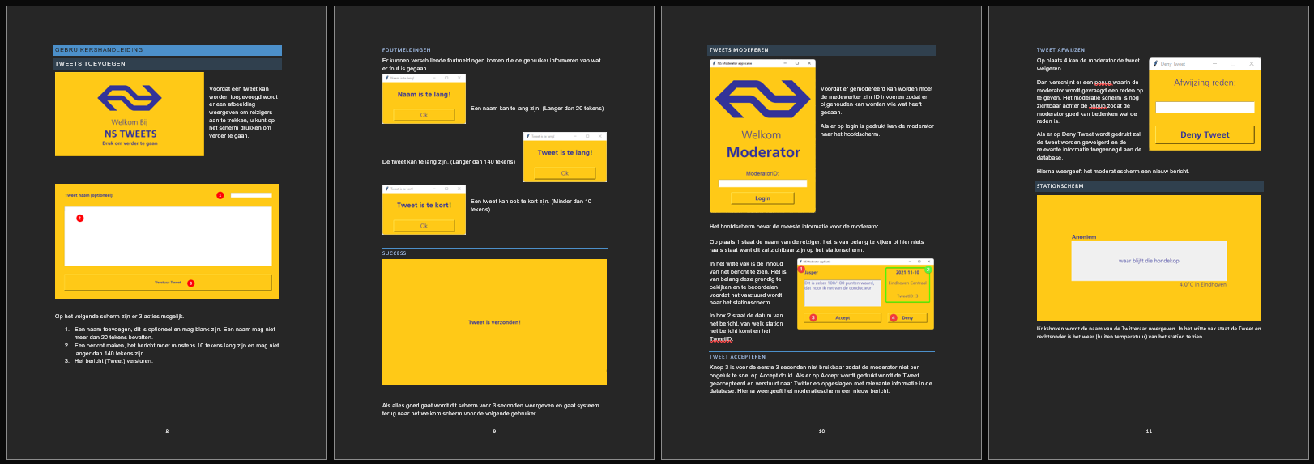
Database
Handleiding
Planning

Slide 7
Demo
Planning
Handleiding

Slide 8
Handleiding
Demo

Slide 9
Demo
Code: Layout

